Slide 1
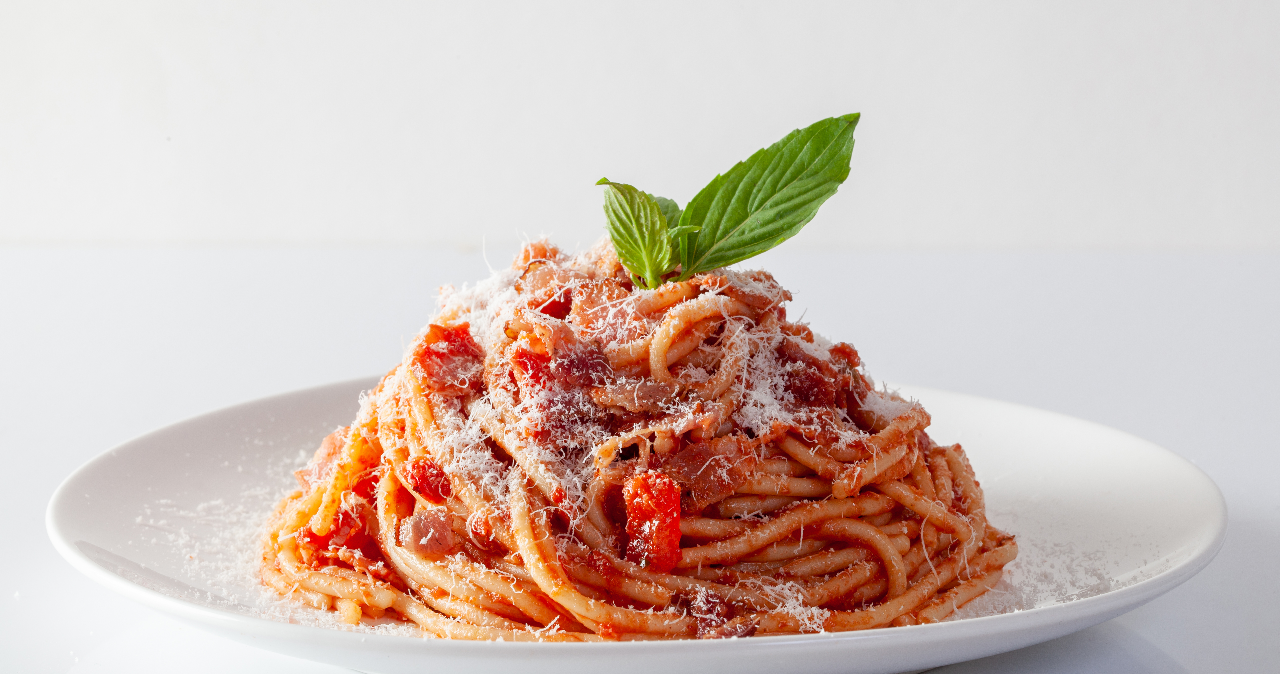
Recip-Ease Tasks and Personas

Slide 2
Tasks
Complex Task: Entering recipes with a variety of measurements and ingredients can be tedious and usually doesn’t offer the best return on investment of a users’ time.
This will be improved upon by using intelligent database searches and machine learning to first narrow the scope of the recipe, then provide a list of most-frequently used ingredients.
Once an ingredient has been chosen, buttons will populate allowing the user to simply click the appropriate measures.
The user is offered a chance to enter a title, a description, and recipe instructions before saving to the database.
Simple Task: Producing an ad-hoc link to an online cookbook of recipes to share with family members.
The website lists the user’s recipes with checkboxes. When the user hits the “Build” button, the website provides a shareable link for the user to send to their friends and family with those recipes.

Slide 3
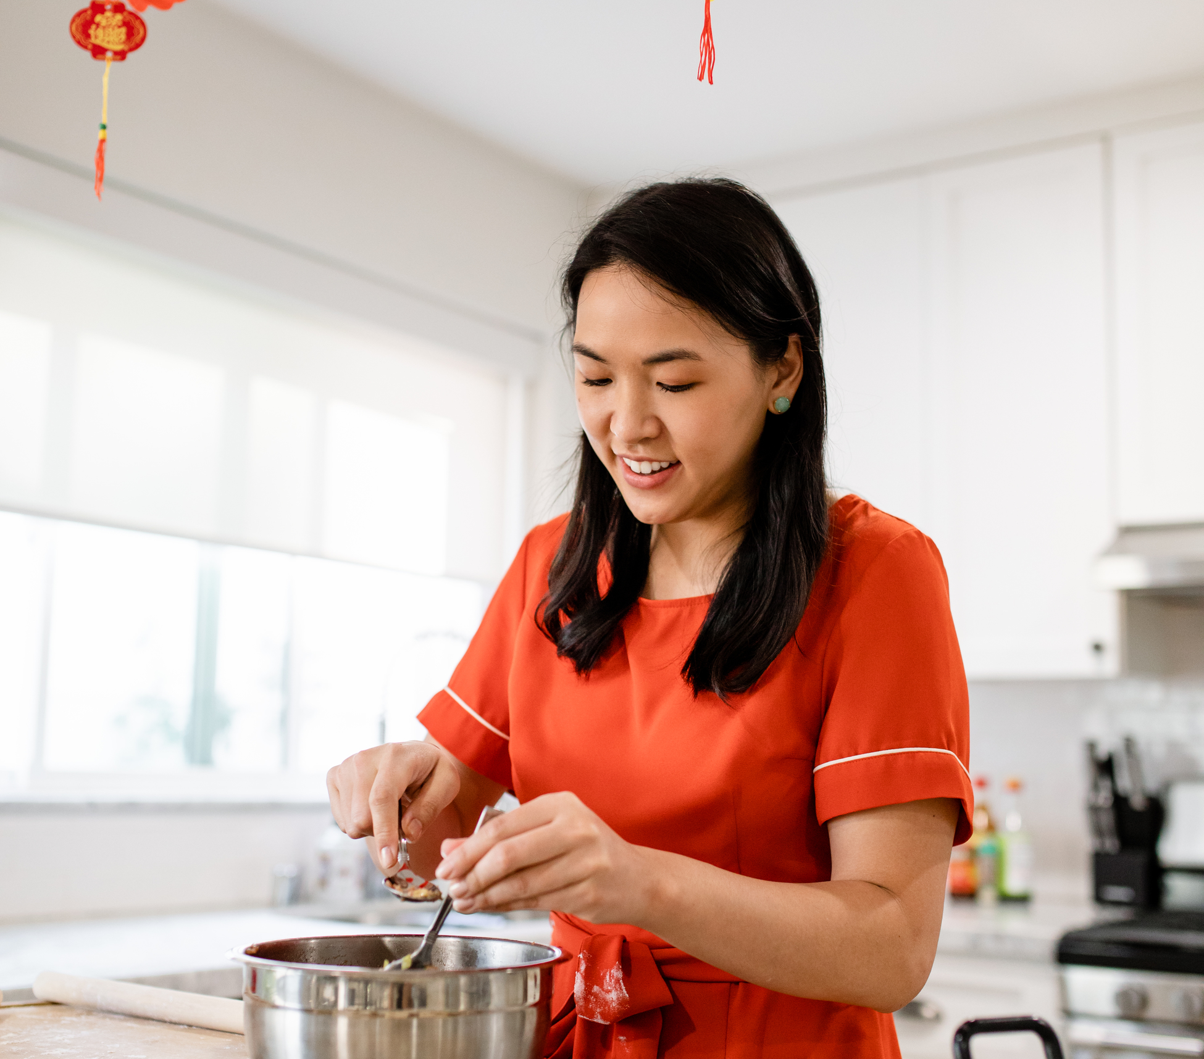
Kimberly Sexton – Family Cook
Background
Project Manager
Working on PPP
Married with two children
Husband is stay-at-home parent
Demographics
Female, 38 years old
Family income $120,000
Small town suburb of Orlando
Identifier/Needs
Family has diverse tastes
Husband doesn’t cook, so meal planning and weekly meal prep are essential
Like exploring a variety of cuisines and meals.

Slide 4
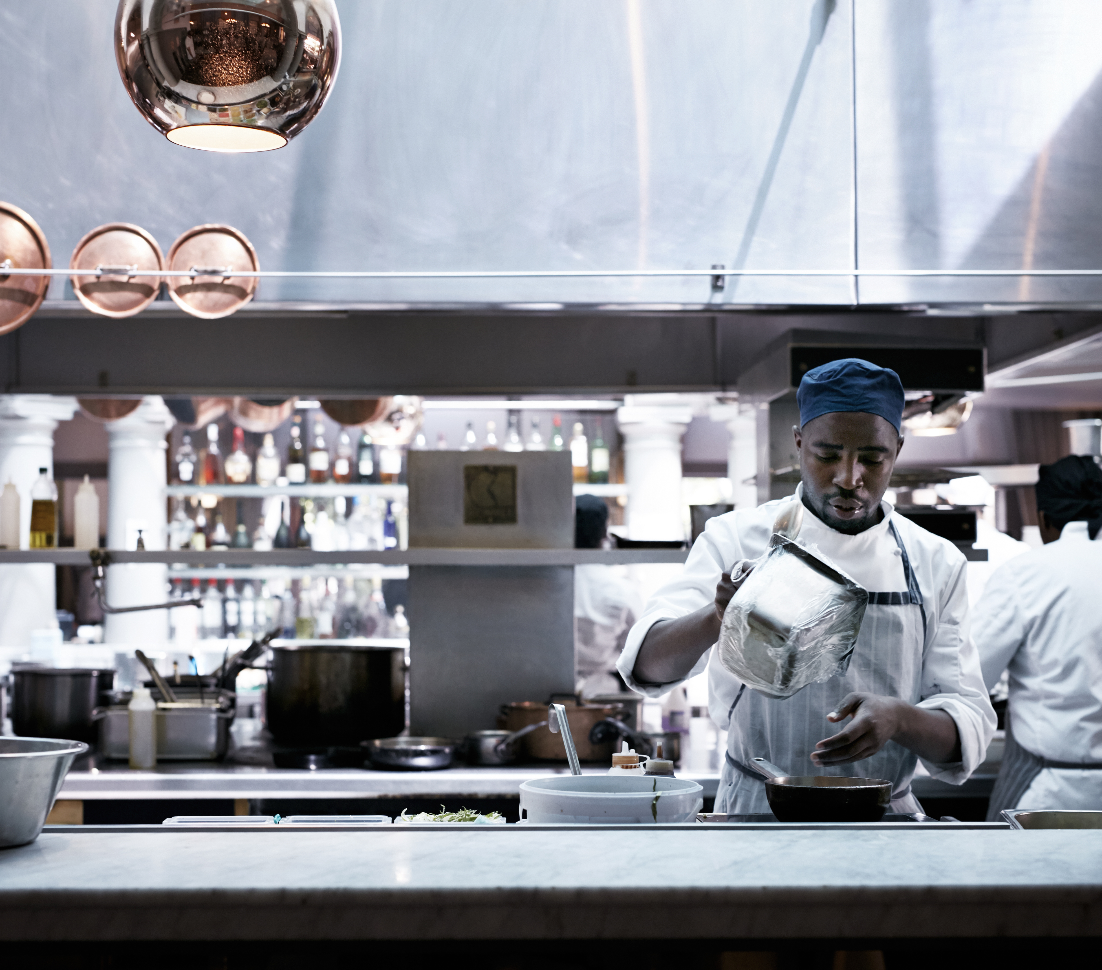
Joseph Ritten– Culinary Explorer
Background
Sous Chef at local 4+ star restaurant
Food hobbyist at home
Building experience
Single with many hungry friends
Demographics
Male, 26 years old
Individual income $75,000
Lives in Downtown Orlando
Identifier/Needs
Likes to explore a variety of cuisines
Creates own dishes/desserts and needs facility to document, save and search for them.
Desires to have the ability to share with friends to critique and try his recipes

Slide 5

Tyler Morgan– Health Enthusiast and Content Creator
Background
Certified nutritionist
Creates healthy food options and produces web content demonstrating cooking same
Partner manages successful whole foods market
Demographics
Male, 33 years old
Individual income varies: $30,000 - $85,000
Lives outside Rochester, NY
Identifier/Needs
Identifies popular dishes and re-creates using healthier and fresher ingredients.
Needs to find a variety of recipes and easily create and store his own versions for his web content.
Must be able to provide current list of recipes for his web users and viewers.

